Slide 1
Introduction to HTML

Slide 2
HTML
HTML is the "mother tongue" of your browser.
→ The term “hypertext” was first introduced by Nelson in 1965.
HTML was invented in 1990 by a scientist called Tim Berners-Lee.
The purpose was to make it easier for scientists at different universities to gain access to each other's research documents.
The project became a bigger success. By inventing HTML he laid the foundation for the web as we know it today.
HTML is a language, which makes it possible to present information (e.g. scientific research) on the Internet.

Slide 3
HTML
H-T-M-L are initials that stand for Hypertext Markup Language .
Hyper is the opposite of linear. It used to be that computer programs had to move in a linear fashion. This before this, this before this, and so on.
HTML does not hold to that pattern and allows the person viewing the World Wide Web page to go anywhere, any time they want.
Text is what you will use. Real, honest to goodness English letters.
Mark up is what you will do. You will write in plain English and then mark up what you wrote.
Language it's a language -- but the language is plain English.

Slide 4
What can I use HTML for?
If you want to make websites, there is no way around HTML.
Even if you're using a program to create websites, such as Dream weaver, a basic knowledge of HTML can make life a lot simpler and your website a lot better.
The good news is that HTML is easy to learn and use.

Slide 5
HTML
Hyper Text Markup Language
A markup language designed for the creation of web pages and other information viewable in a browser
The basic language used to write web pages
File extension: .htm, .html

Slide 6
Creating a HTML File
Open Notepad
Click on File -> Save as…
In the File name pull-down box, type in webpage.html
Click on Save
Type in content for your file
Once you finished the content, click on File -> Save

Slide 7
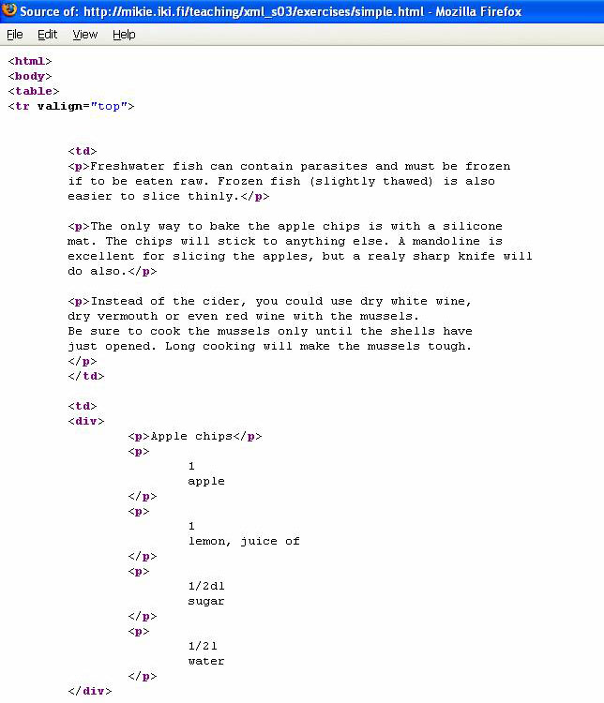
How is a HTML File Looks Like

Slide 8
HTML Tags
Tags are labels you use to mark up the beginning and end of an element.
Tag usually goes with pair: an open tag and an end tag.
All tags have the same format: they begin with a less-than sign "<" and end with a greater-than sign ">".
There are two kinds of tags –
- Opening tags: <html>
- Closing tags: </html>
The only difference between an opening tag and a closing tag is the forward slash "/".
You label content by putting it between an opening tag and a closing tag.
Single tag: <hr>,<br>
Tags are NOT case sensitive
Effect | Code | Code Used | What It Does
Bold | B | <B>Bold</B> | Bold
Italic | I | <I>Italic</I> | Italic

Slide 9
HTML Document Structure
<html>
<head>
<title> Page Title Goes Here </title>
</head>
<body>
content goes here
</body>
</html>

Slide 10
Basic Tags
<html> </html> :-- The entire web page is enclosed within <html> </html> tags.
Within these tags two distinct sections are created using
-- <head> </head>
-- <body> </body>
<head> </head> :-- Information placed within the <head> </head> tags is not displayed in the browser.
<title> </title> :-- It is used to give the title of the web page.
<body> </body> :-- This tag used to indicate the start and end of the main body of textual information.

Slide 11
Structure of an HTML page
<!DOCTYPE html>
<html>
<head>
information about the page
</head>
<body>
page contents
</body>
</html>

Slide 12
Page title: <title>
describes the title of the web page
<title>Chapter 2: HTML Basics</title>
placed within the head of the page
displayed in the web browser's title bar and when bookmarking the page

